Slide 1
MOBILE OS
Android Architecture
Comparison between Android OS Vs iPhone OS
Android Benefits
Zygote
With Notes……
By Vaibhav……

Slide 2

Mobile OS : Android
Android is an open source and Linux-based Operating System for mobile devices such as smartphones and tablet computers.
Android was developed by the Open Handset Alliance, led by Google, and other companies.
The first beta version of the Android Software Development Kit (SDK) was released by Google in 2007 where as the first commercial version, Android 1.0, was released in September 2008.
On June 27, 2012, at the Google I/O conference, Google announced the next Android version, 4.1 Jelly Bean.

Slide 3
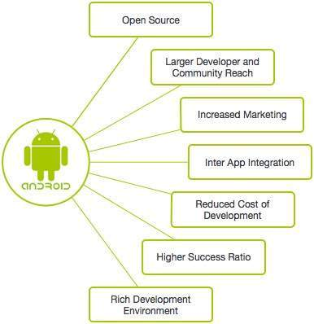
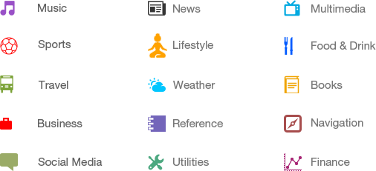
Why Android ?
There are many android applications in the market. The top categories are −

Slide 4
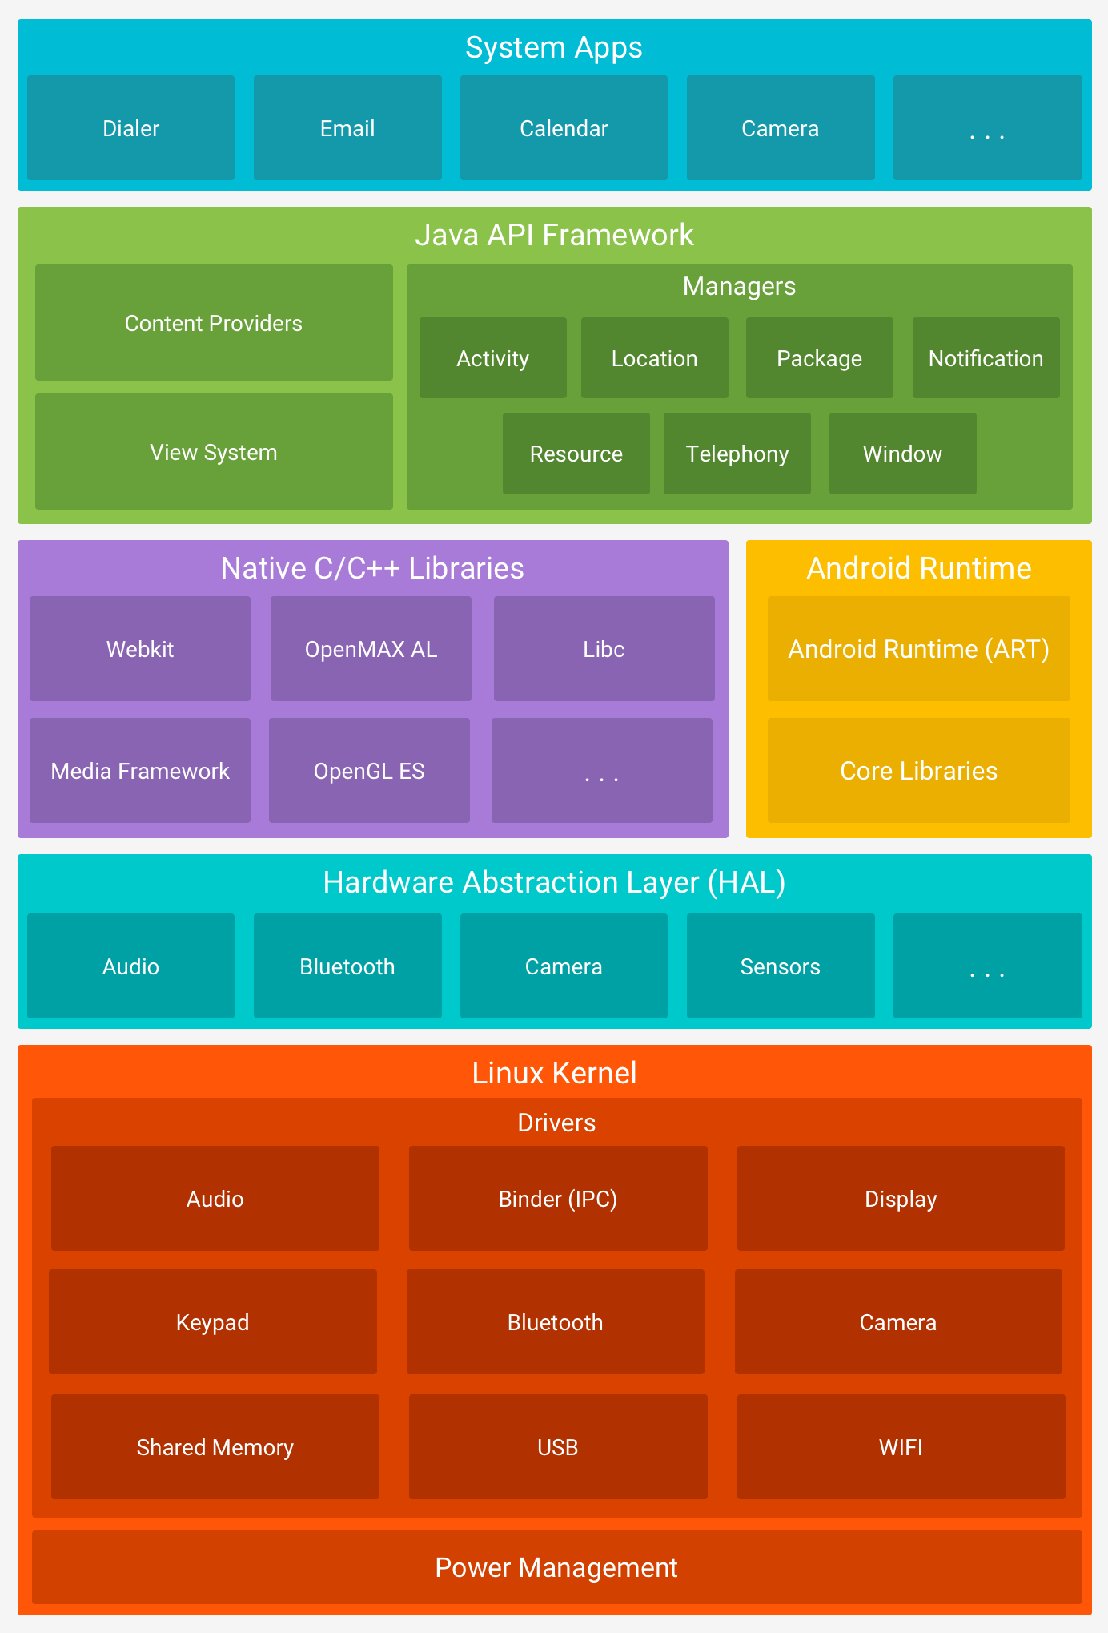
ANDROID ARCHITECTURE

Slide 5
Linux kernel
At the bottom of the layers is Linux - Linux 3.6 with approximately 115 patches.
This provides a level of abstraction between the device hardware and it contains all the essential hardware drivers like camera, keypad, display etc.
Also, the kernel handles all the things that Linux is really good at such as networking and a vast array of device drivers, which take the pain out of interfacing to peripheral hardware.
Hardware Abstraction Layer (HAL):
This layer provides an abstraction layer between the Android platform and the hardware, allowing the platform to work with a variety of hardware platforms and device types.
The hardware abstraction layer (HAL) provides standard interfaces that expose device hardware capabilities to the higher-level Java API framework.
The HAL consists of multiple library modules, each of which implements an interface for a specific type of hardware component, such as the camera or Bluetooth module.

Slide 6
Libraries(Native c/c++)
On top of Linux kernel there is a set of libraries including open-source Web browser engine WebKit, well known library libc, SQLite database which is a useful repository for storage and sharing of application data, libraries to play and record audio and video, SSL libraries responsible for Internet security etc.’
Libraries include a set of C/C++ libraries used by components of the android system. It is exposed to developers through the android developer framework
Application Framework Layer(Java API Framework):
This layer provides the Java framework that developers use to create Android applications.
This layer provides a set of higher-level abstractions that simplify the development of Android applications. It includes components such as activities, services, content providers, and broadcast receivers.
The entire feature-set of the Android OS is available to you through APIs written in the Java language. These APIs form the building blocks you need to create Android apps by simplifying the reuse of core, modular system components and services.
Developers have full access to the same framework APIs that Android system apps use.

Slide 7
ANDROID RUNTIME
Android Runtime (ART) is the managed runtime used by the Android operating system. It is responsible for executing Android applications and provides several features that enable efficient and optimized performance.
Some of the major features of ART include the following:
Ahead-of-time (AOT) and just-in-time (JIT) compilation
Optimized garbage collection (GC)
On Android 9 (API level 28) and higher, conversion of an app package's DEX files to more compact machine code
Better debugging support, including a dedicated sampling profiler, detailed diagnostic exceptions and crash reporting, and the ability to set watchpoints to monitor specific fields
ART also provides improved garbage collection, which is the process of freeing up memory that is no longer being used by an application.
Overall, ART is a key component of the Android operating system that helps to ensure that Android applications run efficiently and smoothly on a wide range of devices.

Slide 8
APPLICATION LAYER( SYSTEM AAPS)
The Application Layer is the topmost layer of the Android architecture and is where all user-facing applications run. This layer is responsible for providing the user interface and the functionality that the user interacts with.
Applications in the Android operating system are developed using the Java programming language and are packaged as APK (Android Package) files. These APK files contain all the resources required by the application, including the code, images, and other assets.
The Application Layer in the Android architecture is a critical component, as it is responsible for providing the user experience and functionality that makes Android devices so useful and popular. Without this layer, users would not be able to interact with the Android operating system or use any of the applications that run on it.
Android comes with a set of core apps for email, SMS messaging, calendars, internet browsing, contacts, and more. Apps included with the platform have no special status among the apps the user chooses to install. So, a third-party app can become the user's default web browser, SMS messenger, or even the default keyboard. Some exceptions apply, such as the system's Settings app.

Slide 9
Comparison between Android OS Vs iPhone OS
iOS:
iOS is a mobile operating system that is provided by Apple Incorporation. It is mainly designed for Apple mobile devices like iPhone and iPod Touch. It was earlier known as iPhone OS. It is a Unix-like operating system that is based on Darwin’s (BSD) operating system. It is the world’s second most used mobile operating system after Android. It is mainly written in C, C++, Objective-C, assembly language, and Swift. The first version of iOS was launched in 2007.
2. Android :
Android is a mobile operating system that is provided by Google LLC. It is based on the modified version of the Linux kernel and other open-source software. It is specifically designed for touchscreen mobile devices like smartphones and tablets. It was developed using C, Java, C++, and other languages. The first version of Android was launched by Google in 2008. The latest stable version of Android is Android 10. It is provided totally free of cost. It is the most used operating system overall.

Slide 10
S.No. | IOS | ANDROID
1. | It was developed and is owned by Apple Incorporation. | It was developed by Google and Open Handset Alliance and is owned by Google LLC.
2. | IOS was initially released on July 29, 2007 | Google was initially released on 23 September 2008.
3. | when IOS was released its first version is iPhone OS 1 before named IOS. | When Google released its first version of Android 1.0, Alpha.
4. | It was launched in 2007. | It was launched in 2008.
5. | Latest stable release version: iOS 15.3.1 and iPadOS 15.3.1 | Latest stable release version: Android 12
6. | Its target system types are smartphones, music players, and tablet computers. | Its target system types are smartphones and tablets.
7. | It is specially designed for Apple iphones and ipads. | It is designed for smartphones of all companies.
8. | Its kernel type is Hybrid. | Its kernel type is Linux-based.
9. | It has preferred license is Proprietary, APSL, and GNU GPL. | It has the preferred license of Apache 2.0 and GNU GPLv2.
10. | It is mainly written in C, C++, Objective-C, assembly language, and Swift. | It is written using C, C++, Java, and other languages.

Slide 11
. 11 | Its update management is Software Update. | Its update management is Systems Software Update.
12. | Swift is majorly used for iOS application development. | Java and Kotlin are majorly used for Android application development.
13. | IOS has a Commercial Based Source model with open source components. | Android is an Open Source based Source model.
14. | IOS-based Devices have Safari as the default Internet Browser. | Android devices have google chrome but one can install any Internet Browser.
15. | IOS has Siri as Voice Assistant. | Google has Google Assistance.
16. | IOS-based devices have the feature of blocking 3rd party app stores. | But Google doesn’t block 3rd party app stores.
17. | IOS devices are available in 40 languages. | Android Devices are available in 100+ languages.
18. | In IOS customizability is limited unless jailbroken. | In Android, we can change almost anything.
19. | File transfer in android is easier than in IOS. | File transfer in IOS is more difficult than in android.
20. | None on the iPhone 7 and later; lighting 3.5mm no longer comes with the phone after the iPhone XS. | have a headphone jack, but some current Android smartphones lack a headphone jack.

Slide 12
ANDROID BENEFITS
Android is a popular mobile operating system developed by Google. Some of the benefits of Android include:
Customization: Android is highly customizable, allowing users to personalize their devices with various widgets, wallpapers, launchers, and themes.
2. App Store: The Google Play Store has a vast collection of applications that are easily accessible, allowing users to download and install different types of apps, games, and utilities.
3. Open Source: Android is an open-source platform, which means that developers can access its source code and modify it according to their needs.
4. Multiple Devices: Android is used by many different smartphone manufacturers, providing users with a range of devices with various features and prices.
5. Google Integration: Android is developed by Google, which means that it integrates well with Google's services like Google Maps, Google Drive, Gmail, and more.
6. Voice Assistant: Android has a built-in voice assistant called Google Assistant, which can perform various tasks and functions using voice commands.
7. Security: Android provides regular security updates to ensure that users' devices are protected from malware, viruses, and other security threats.
8. Multitasking: Android devices allow users to run multiple applications simultaneously, making it easier to switch between apps and complete tasks more efficiently.

Slide 13
ZYGOTE
a "Zygote" is a system process that is responsible for creating and launching new applications on an Android device.
When an application is launched on an Android device, the Zygote process is responsible for creating a new Dalvik Virtual Machine (DVM) instance, which is used to run the application.
The Zygote process preloads commonly used classes and resources, so that subsequent application launches can be faster.
The Zygote process is started when the Android device is booted up and runs continuously in the background.
It is designed to reduce the time and resources required to start new applications on an Android device, by creating a shared environment for all the applications that are launched.
Overall, the Zygote process is an important component of the Android operating system that plays a critical role in the performance and efficiency of the system.

Slide 14


